Slide 1
Real Estate Investment Trust
A Predictive Analytics Study
Sayon Sengupta

Slide 2
Content
Business Case
(The transaction price of 1883 real estate properties were evaluated)
Data Acquisition
(Data was obtained in CSV format)
Data Preparation
(Data Cleaning through Azure)
Data Visualisation
(Descriptive Statistics through Tableau )
Exploratory Data Analysis
(Independent features selected for further analysis)
Feature Significance Testing
(Performing Feature Importance Analytics using Chi-Squared Testing)
Evaluation
(Applied Chi-square for Categorical Variables and Correlation for Numeric Variable)
Conclusion
(Predictive Analysis)
Operationalisation
(Prescriptive Analysis)
Notes:
Business case- data acquisition- data preparation- data visualization- exploratory data analysis- hypothesis modeling- evaluation- conclusion- operationalization

Slide 3



Data Preparation
Total Number of records: 1883
No duplicates were found
Data has been cleaned.
Found total of 803 missing values. Handled by replacing with mode.

Slide 4
Exploratory Data Analysis
The Features (i.e. Variables) were segregated into 5 Categories
Predictor (Y) Variable
NOISE FEATURES
FEEDER/
CHEATER
INDEPENDENT
Redundant
Missing values
Transaction Price
Year Built
Tax Year
None
None
Exterior walls
Roof
Basement
Beds
Baths
Sqft
Lot size
Property type
Exterior walls
Roof Basement
Restaurants
Groceries
Nightlife
Insurance
Property Tax
Café
Shopping
Arts and Entertainment
Beauty Spas
Active life
Median age
Married
College grad
Median School
Num School

Slide 5
Data Visualizations

Slide 6
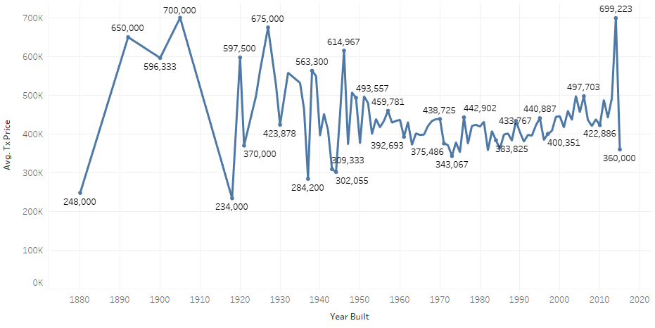
Year Built VS Avg. Transaction Price
This graph shows the average transaction price every year there was a new property built
The graph shows the highest Avg Transaction price in year 1905

Slide 7
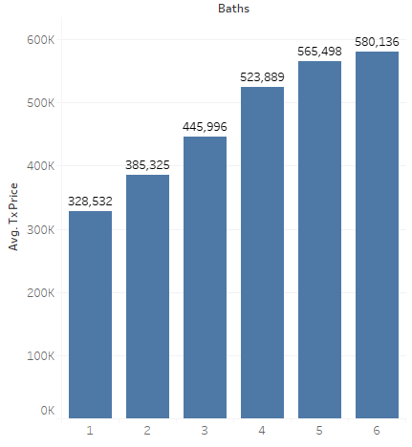
Baths VS Avg Transaction price
This graph shows the correlation between number of baths and average transaction price
We can infer that properties that have 6 baths on average have higher transcation prices.

Slide 8
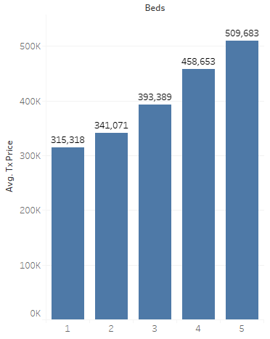
Beds VS Avg. Transaction Price
This visualization analyzes the number of beds to the average transaction price
As the number of beds increases the average transaction price also increases

Slide 9
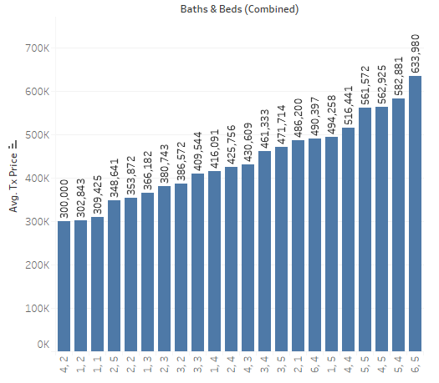
Baths & Beds VS Average Transaction Price
This visualization analyzes the relationship between baths & beds with the average transaction price
Interestingly the lowest transaction price on average went to 4 bath and 2 beds

Slide 10
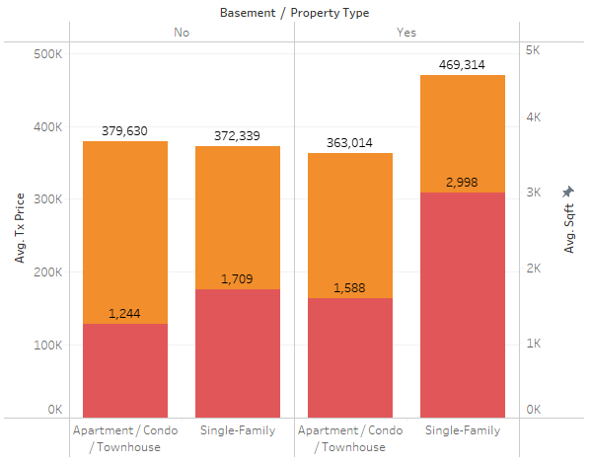

Basement/Property type VS Average Transaction Price and Average Sqft
We can infer from the graph that single family properties without basements have lower transaction prices on average than Apartment/Condos/Townhouses whereas single family properties with basements have higher transaction prices on average than Apartment/Condos/townhouses
Furthermore, we can see an increase in property sqft from apartment/condos/townhouses to single family properties where a basement is absent and present.

Slide 11
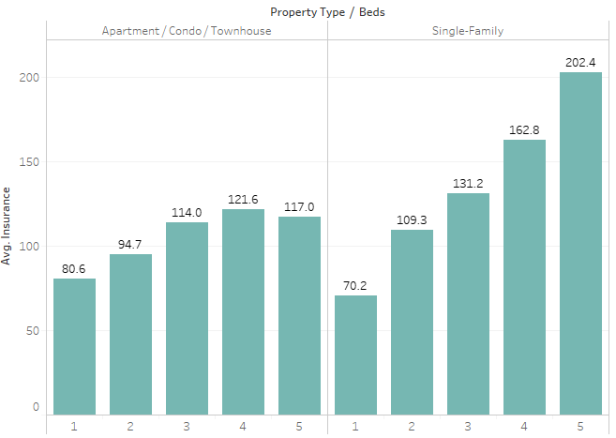
No. Beds per Property Type VS Avg Insurance
We can infer that as the number of beds increases the insurance price usually increases

Slide 12
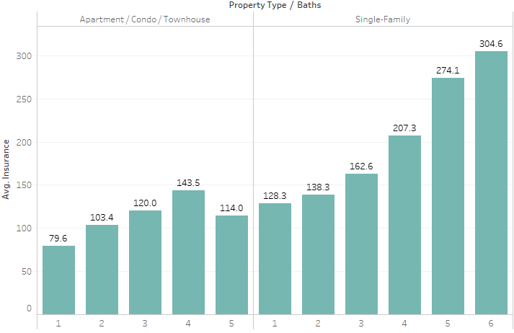
No. Baths per property type VS Avg. Insurance
We can infer that as the number of baths increases for a property type the avg. insurance also increases. Except for

Slide 13
Hypothesis and Modeling

Slide 14
Feature Engineering
Features with the greatest predictive power on tx_price (least to greatest):
Insurance 9. roof 17. active_life 25. basement
Property_tax 10. college_grad 18. Shopping
Sqft 11. Married 19. groceries
Beds 12. property_type 20. nightlife
Baths 13. beauty_spas 21. median school
Lot_size 14. year_built 22. arts_entertainment
Exterior_walls 15. median_age 23. cafes
Tx_year 16. restaurants 24. numschool

Slide 15
Best Machine Learning Models
Train data was trained with 50 random forest, 50 eXtreme Gradient Boosting and 100 glmnet algorithms
The 2nd to best model was eXtreme Gradient Boosting with an r squared value of .78, RMSE of 72,000

Slide 16
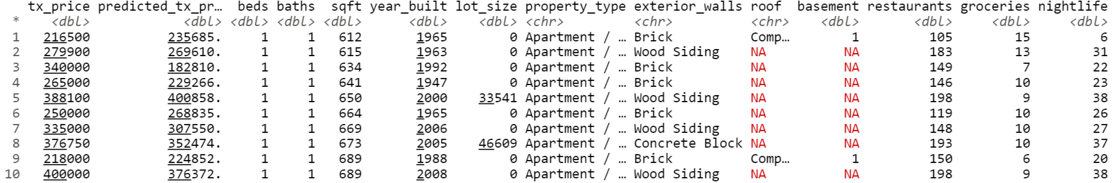
Predictions
10 predicted values using the test data set:

Slide 17
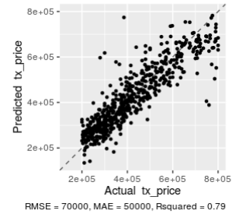
Predictions Cont.
Predictions are made within a RMSE value of 70,000

Slide 18
Conclusion
Since we see a RMSE value of 70,000 and r squared of .95 our ML trained model is a more accurate than the appraisers for the REIT
We can submit this trained model to the client and do further exploration to improve the accuracy via feature engineering.

